Slide 1
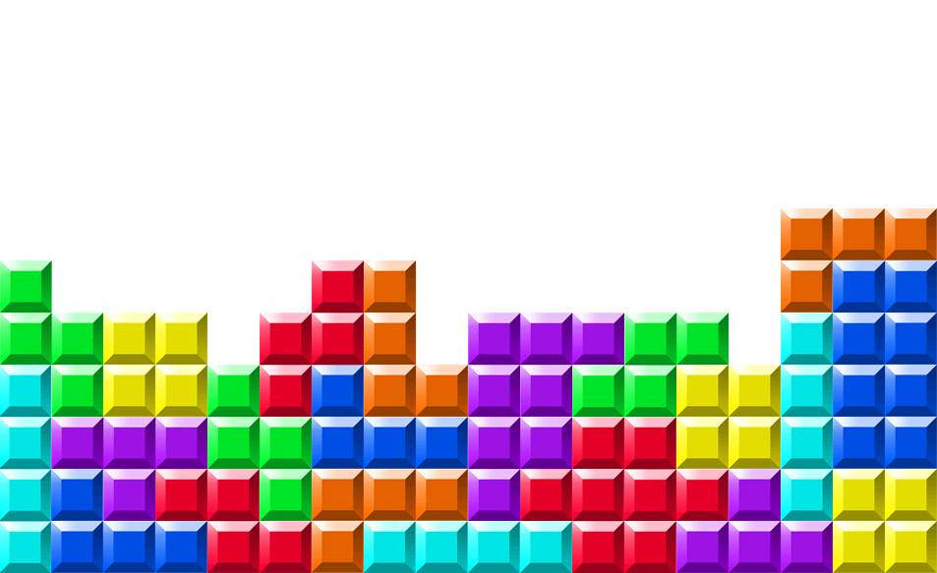
Counting Polyominoes
Presented by Lihi Panaola

Slide 2

papers
Counting polyominoes: yet another attack D.Hugh Redelmeier [1979]

Slide 3
What Is Polyomino?
A collection of equal-sized squares in a plane – Cells.
Polyominoes must be connected.
The size of a polyomino is the number cells it contains.

Slide 4
The main goal
How many polyominoes of size p are there?

Slide 5
The two kinds of polyominoes
Free polyominoes are considered distinct if they have different shapes.
Fixed polyominoes are considered distinct if they have different shapes or orientation.
We will use free(p)/fixed(p) to denote the number of free/fixed polyominoes of size p.

Slide 6
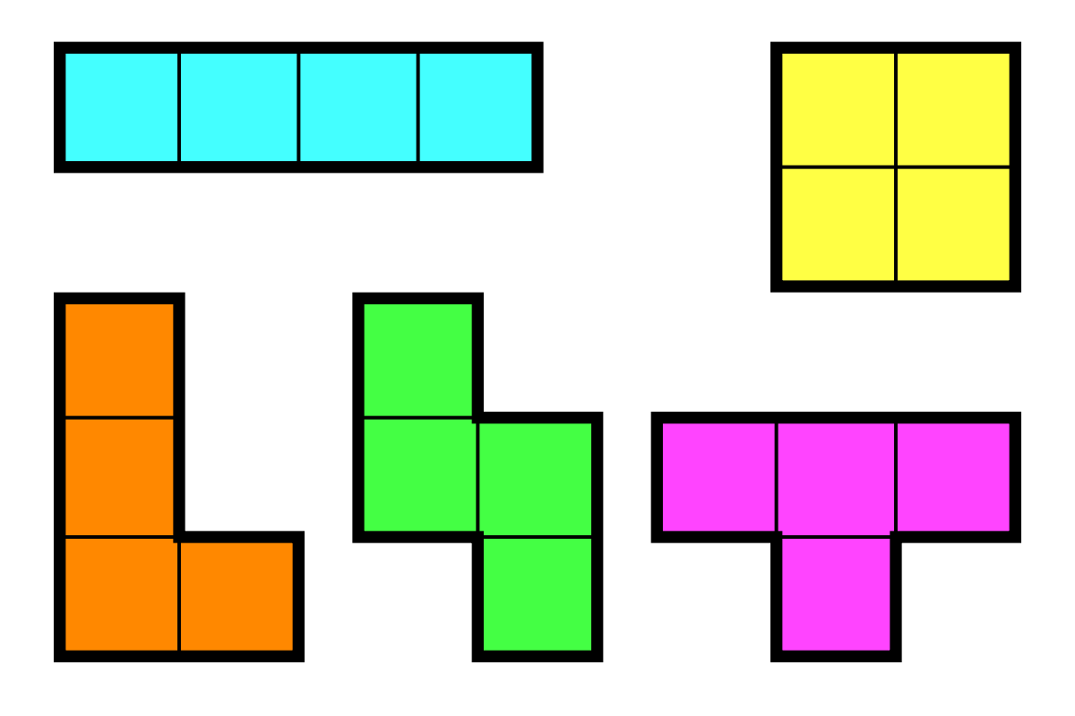
tetromino

Slide 7
Symmetries of polyominoes
The key to differentiate between fixed and free.
Every free polyomino corresponds to one, two, four or eight fixed polyominoes.
A polyomino is said to have a certain symmetry if it is invariant under transformation(s) associated with that symmetry.

Slide 8



Examples of symmetry
Rotation by $π radians$
Reflection in vertical axis
Reflection in ascending diagonal

Slide 9
Examples of symmetry
A very symmetric free polyomino
An asymmetric free polyomino

Slide 10
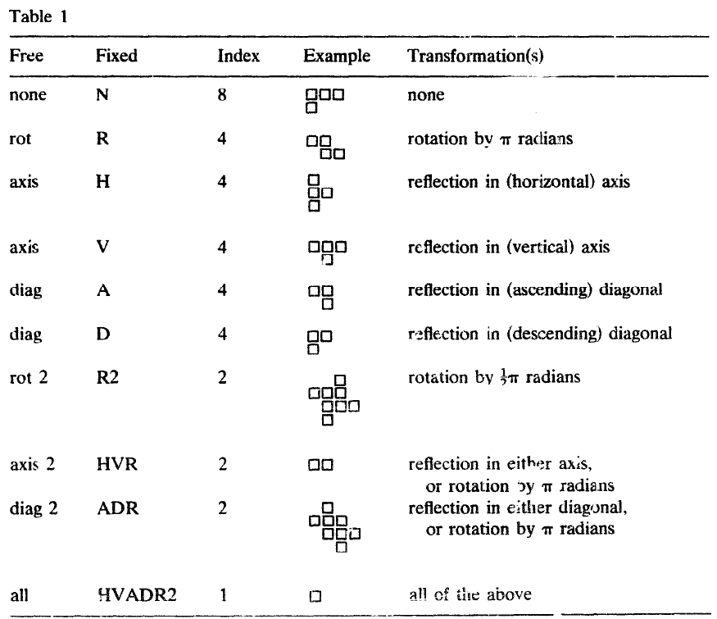
Symmetries of polyominoes

Slide 11
Symmetries of polyominoes
Symmetry with index 4 is a simple symmetry.
Symmetry with index less than 4 is a composite symmetry.
Most polyominoes have no symmetry.
There are less polyominos with composite symmetries than with simple symmetry.
fixed(p) is approximately eight times free(p).

Slide 12

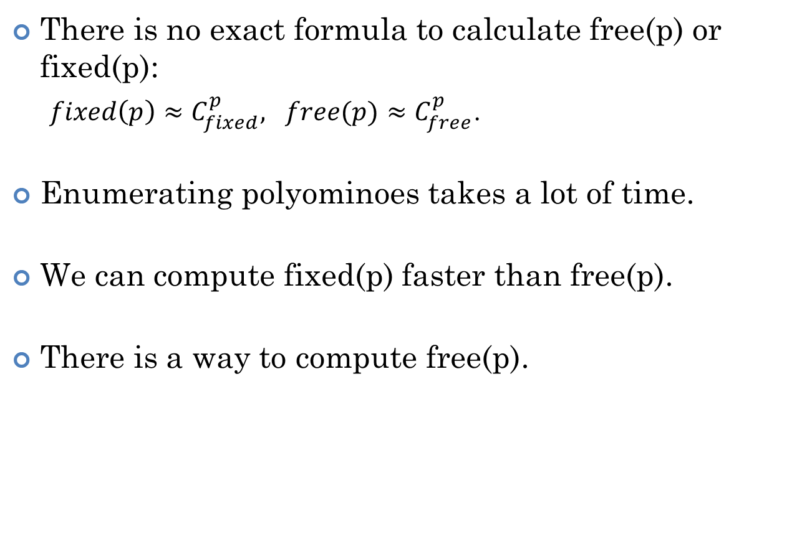
How many polyominoes are there?
There is no exact formula to calculate free(p) or fixed(p):
$fixed\left(p\right)≈C_{fixed}^{p}, free(p)≈C_{free}^{p}$.
Enumerating polyominoes takes a lot of time.
We can compute fixed(p) faster than free(p).
There is a way to compute free(p).

Slide 13
Algorithm to enumerate fixed polyominoes
A cell at the origin of the cartesian lattice.
The algorithm calculates fixed(p) for p up to specified limit P.
Depth-first traversal of a “family tree” of all polyominoes.
y
input - P
x
output
fixed(1)+fixed(2)+…+fixed(P)

Slide 14
The algorithm
During the running of the algorithm each point in the field can be in one of four states:
Border
Occupied
Reachable
Free
y
x

Slide 15
The algorithm
The algorithm is started with one parent being the empty polyomino, and the untried set containing only the origin.
Remove an arbitrary element from the untried set.
Place a cell at this point.
Count this new polyomino.
If the size is less than P:
Add new neighbours to the untried set.
Call this algorithm recursively with the new parent being the current polyomino, and the new untried set being a copy of the current one.
Remove the new neighbours from the untried set.
Remove newest cell.

Slide 16
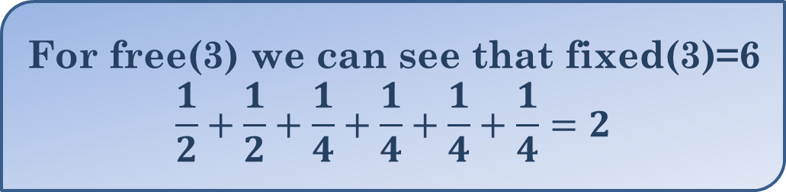
Example for p=3
Free(p) is the sum, for each fixed polyomino, of the inverse of the index of the polyomino symmetry.
For free(3) we can see that fixed(3)=6
$$\frac{1}{2}+\frac{1}{2}+\frac{1}{4}+\frac{1}{4}+\frac{1}{4}+\frac{1}{4}=2$$

Slide 17
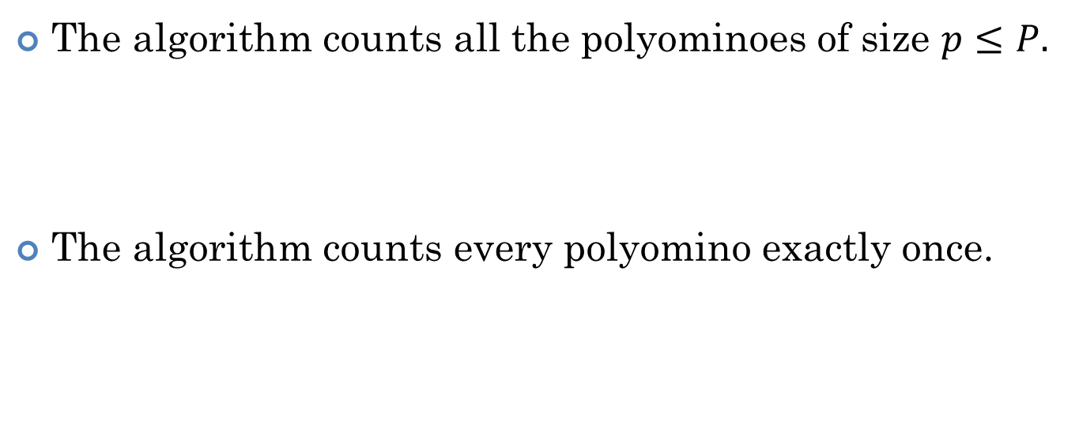
Correctness of the algorithm
The algorithm counts all the polyominoes of size $p≤P.$
The algorithm counts every polyomino exactly once.

Slide 18
The data structure aspect
The successor of an element in the untried set is the next-newest element.
We can present the untried set as a linked list.
Free information and successor information represented as matrices with one element for each point in the field that can be used.
y
p-1
-p+1
-1
p-1
x

Slide 19

Results
The program coded in fewer than 50 statements.
The assembly version on the PDP-11/70 computer runs ten months of CPU time.
The symmetric enumerate took less than 5 minutes on IBM 370.

Slide 20
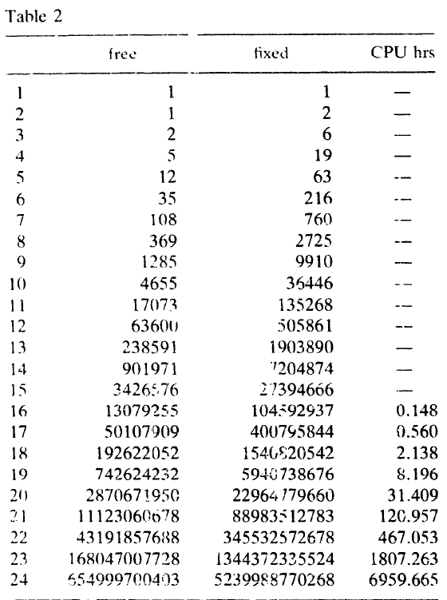
Values of free(p) and fixed(p)

Slide 21
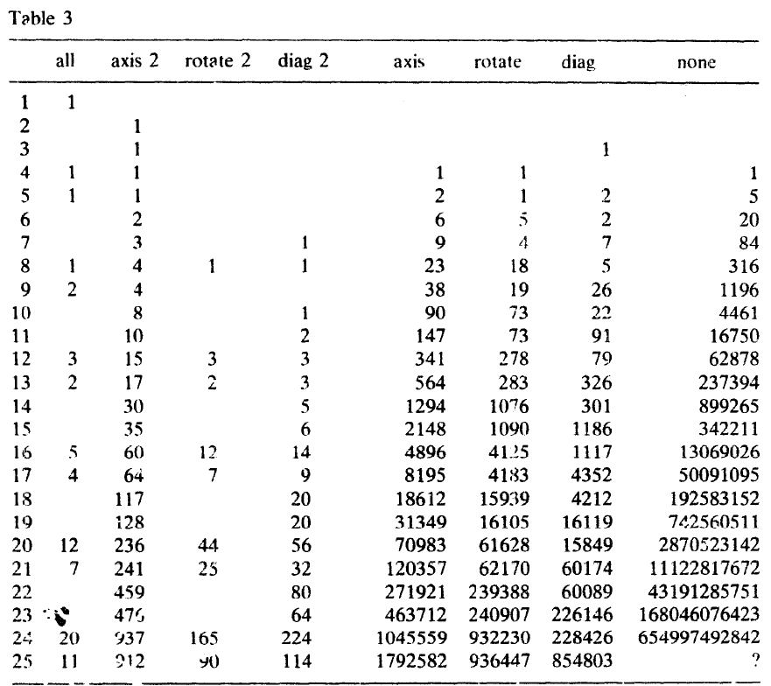
Number of polyomino in each free symmetry type

Slide 22

Any Questions?

Slide 23




